Slide 1



BSRUN for Strategy and Practice for the Friends of the Baltic Sea Region
St.Petersburg
8 February 2017
Kari Hyppönen
President of BSRUN

Slide 2
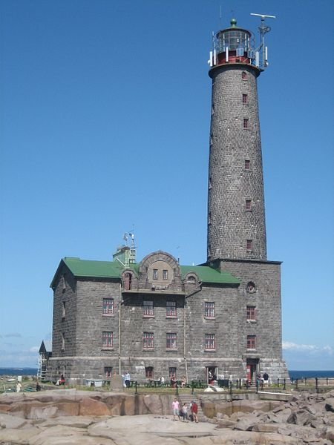
www.bsrun.org
Established in 2000 with 16 universities in Estonia, Finland, Latvia, Lithuania, Poland and Russia;
Currently about 30 institutions in Belarus, Estonia, Finland, Germany,
Latvia, Lithuania, Poland and Russia
Coordinators:
- University of Turku 2000-30.6.2010,
- University of Latvia 1.7.2010-2013,
- UWM and UNECON 2014-16,
- UW and UNECON 2017-19.
The importance of having two secretariats: EU (legal representative) and Russia for better services for the members and internal communication and finances

Slide 3
MEMBERS
Institutions primarily from the Baltic Sea region
drainage area;
Universities and universities of applied sciences
Based on agreement between members;
Associate membership for networks etc.
Commitment to the cause of cooperation with neighbours

Slide 4
OBJECTIVES
Strengthening collaboration in University Governance, Management and Administration;
Developing a platform for new ideas, projects and activities;
Facilitating and promoting contacts and exchanges of information and experience;
Enhancing cooperation with the networks and associations agreed upon separately

Slide 5








PARTNERS
NUAS, EAIR, ESMU, NDI, BUP, BUN and UArctic (University of the Arctic);
Strategic partner of CBSS (Council of the Baltic Sea States);
Observer at BSPC (Baltic Sea Parliamentary Conference);
Member of EUSBSR HA Neighbours Coordination Group.

Slide 6





PARTNERS
Associate member of Triple I, Aurora, BMU-MID, MID (EMA2) ;
Associate member of BSN (Baltic Science Network) (Interreg Baltic Sea);
Marketing Baltic TRAM;
FOSTERC Erasmus+ for Belarus
EU-Drivers and MODERN (ESMU);

Slide 7
FRAMEWORK
Is cross-border university cooperation within the Baltic Sea region important?
Enthusiasm of the 1990's;
Globalisation/Europeanisation of higher education and the enlargement of the EU;
Demise of CBUR in early 2000s;
BUP and BSRUN still active;
Operating environment has changed

Slide 8



FRAMEWORK
Policy oriented: EUA, EU2S2;
Regional: BSRUN, BSUN, UniMed;
Academic subject/field oriented: UTech, Life Sciences, Business Schools;
Research oriented: League of European Research Universities (LERU), LERU-CE7, Guild of European Research-Intensive Universities;
Coimbra, UNICA, SGroup,UIIN…ENUO

Slide 9
FRAMEWORK
BSRUN is not a network for world-class teaching and research, nor for EU only; Prestige of membership?
Members are encouraged to find partners for projects/ programmes/research; How to do this better?
University and research profiles and priorities (mergers, name changes etc.)
From teaching to research institutions/Rankings effect
Guarantees for a future: ownership and commitment of the senior management of members (and contacts!)
92 events with 4646 participants (BY 426, EE 241, FI 675, LV 663, LT 771, PL 551, RU 1010 and 309 others).

Slide 10
ACTIVITIES
Enhanced cooperation in teaching and research based on member needs (not another BUP);
University-business-city/region partnerships;
Innovation and development;
Reform of higher education (legislation, governance, mergers, branding, student life);
Financial and real estate management;
International project applications/management.

Slide 11
ACTIVITIES
Increased interest in joint projects (Tempus, CBSS/EuroFaculty/PSF/SU, EMA2, E+, NCM);
BSRUN as a facilitator for EU/Russia/Belarus cooperation;
EuroFaculties (Riga, Tartu, Vilnius, Kaliningrad, Pskov and Turku, UNECON, St.Petersburg State University) and future links between partners (e.g. MA Programmes);
Strategic partnerships for BSRUN and members

Slide 12

ACTIVITIES/CBSS
University networking for quality and development, Kaliningrad, 7 June 2013;
The future of EuroFaculties (follow-up study) 2013-2014;
Frameworks for university cooperation in the Baltic Sea region, Turku, 26 October 2013;
Experiences of EuroFaculties for Belarus, Minsk, 4 March 2014;

Slide 13
ACTIVITIES
Annual BSRUN Forum, University Cooperation in the BSR: Fruitful Cooperation or Lost Opportunities, St. Petersburg, 14-16 May 2014
Baltic Sea Days in Turku, 2-5 June 2014
History, Culture and Nature of the BSR, Olsztyn, 23-24 October 2014
EU Strategy in the Sphere of Education in the BSR, St. Petersburg, 20 October 2014
Annual BSRUN Forum, University Mergers, Warsaw, 20-21 April 2015
Regional Identity, Klaipeda University, 24-25 September 2015
University Real Estate Management, St. Petersburg, 8 October 2015

Slide 14
ACTIVITIES
CIMO seminar Melting the Ice: Ten Years of Success, 10th seminar on Finnish-Russian cooperation in HE,
St. Petersburg, 10-11 February 2016
Agroforum Mare Balticum, Tartu,19-21 April 2016
Competence Development and University Curricula,
Minsk, 18 May 2016 (FOSTERC)
University Real Estate Management, Gdansk University of Technology, Gdansk, 2-3 June 2016
Plenary Meeting and Annual BSRUN Forum, University of Warsaw, 25-26 October 2016
Notes:
14

Slide 15
ACTIVITIES
Student Life at Universities: Culture, Sport, Dormitories etc.;
Fostering Competencies in Belarusian Higher Education, Minsk, 30 March 2017
University Rankings, Gdansk, June 2017;
University Real Estate Management and Development (Outsourcing);
Cooperation in Business, Management and Economics, Warsaw, April 2017;
University cooperation in BSR, Quo vadis?

Slide 16
ACTIVITIES/CBSS
CBSS Summer Universities in 2016: UNECON, Södertörn and Agder;
No coordination meeting in October 2016;
Continuation of cooperation between CBSS and BSRUN in marketing Summer Universities in 2017, if appropriate;
CBSS in Education in the changing financial and political environment?

Slide 17
BALTIC SEA REGION
The political situation in the region has affected membership (Lithuanian group action in BSRUN);
BUP had 225 members, now 62 (+154);
We cannot change geography;
The Baltic Sea unites us, but we decide whether to use it or not for better or worse;
Stronger together for strategy and practice;
Commitment to open discussion channels

Slide 18
THANK YOU!

